Slide 1
Advanced Deep Learning ZG513
Prepared by Dr. Sugata Ghosal and notes by Aakash Goel
Notes:
We’re learning how to replace many raw variables with a few informative summaries. Example: 200 CAN/telematics features → 10 components representing ‘drive style’, ‘load’, ‘thermal regime’, and ‘road roughness’. Then cluster vehicles or detect anomalies. Engage: Quick ask: In your work, what is the ‘latent thing’ you wish you could measure directly—quality, health, stress, or driver behavior?

Slide 2
Session Content
Factor Analysis
Principal Component Analysis (PCA)
Randomized PCA
Incremental PCA
Kernel PCA
Independent Component Analysis (ICA)
Canonical Correlation Analysis (CCA)
Locally Linear Embeddings (LLE)
Reading: R1: Hands-On Machine Learning …, Chapter 8
Notes:
We’re learning how to replace many raw variables with a few informative summaries. Imagine you’re looking at a vehicle with 300 dials on the dashboard. No driver can use that. Factor/component analysis builds a new dashboard with maybe 5–20 needles that summarize the car’s state. Those needles are weighted mixes of many sensors—so the ‘needle’ moves when the underlying phenomenon changes.

Slide 3
Factor or Component Analysis
Discover a new set of factors/dimensions/axes against which to represent, describe or evaluate the data
For more effective reasoning, insights, or better visualization
Reduce noise in the data
Typically a smaller set of factors: dimension reduction
Better representation of data without losing much information
Can build more effective data analyses on the reduced-dimensional space: classification, clustering, pattern recognition
Factors are combinations of observed variables
May be more effective bases for insights, even if physical meaning is obscure
Observed data are described in terms of these factors rather than in terms of original variables/dimensions

Slide 4
Basic Concept
Areas of variance in data are where items can be best discriminated and key underlying phenomena observed
Areas of greatest “signal” in the data
If two items or dimensions are highly correlated or dependent
They are likely to represent highly related phenomena
If they tell us about the same underlying variance in the data, combining them to form a single measure is reasonable
Parsimony - use fewer variables if they explain the same behavior.
Reduction in Error - fewer redundant variables usually means less overfitting, less noise sensitivity, and more stable models
So, we want to combine related variables, and focus on uncorrelated or independent ones, especially those along which the observations have high variance
We want a smaller set of variables that explain most of the variance in the original data, in more compact and insightful form
Notes:
Intuition behind why PCA / factor analysis works at all. The first idea is variance: the parts of the data where values change a lot are often where the signal lives.
If a feature hardly changes across vehicles or parts, it can’t help you tell anything apart. But if it changes strongly across conditions—like load, road, temperature, or defect severity—then it helps us discriminate between cases and observe the underlying phenomenon
second idea is correlation. If two variables are highly correlated, it usually means they’re reacting to the same underlying cause. For example, in fleet telematics, speed and RPM can be correlated; in manufacturing, two dimensions might move together due to the same fixture misalignment; in EVs, temperature rise and internal resistance indicators can rise together. If two variables are basically telling the same story, keeping both is like asking the same question twice.
We’re building a compressed but useful representation.
Variance tells us where differences exist; differences are where learning happens.
Signal is repeatable structure; noise is random wiggle.
Correlation is a clue that two sensors are reacting to the same hidden knob.
Instead of two overlapping features, I’ll make one clean summary feature.
Simpler often generalizes better.
Keep the big, unique directions; drop the small, repetitive ones.
We’re building a compressed but useful representation.

Slide 5
Basic Concept
What if the dependences and correlations are not so strong or direct?
And suppose you have 3 variables, or 4, or 5, or 10000?
Look for the phenomena underlying the observed covariance/co-dependence in a set of variables
Once again, phenomena that are uncorrelated or independent, and especially those along which the data show high variance
These phenomena are called “factors” or “principal components” or “independent components,” depending on the methods used
Factor analysis: based on variance/covariance/correlation. so it models shared variation and often includes an explicit notion of noise per variable.
Independent Component Analysis: it aims for statistical independence, not just uncorrelated directions. That is useful when we believe observed signals are mixtures of independent sources—like mixed vibration sources or mixed interference in sensor signals.

Slide 6
Why Factor or Component Analysis?
We study phenomena that can not be directly observed
ego, personality, intelligence in psychology
Underlying factors that govern the observed data
We want to identify and operate with underlying latent factors rather than the observed data
E.g. topics in news articles
Transcription factors in genomics
We want to discover and exploit hidden relationships
“beautiful car” and “gorgeous automobile” are closely related
So are “driver” and “automobile”
But does your search engine know this?
Reduces noise and error in results
Notes:
we often want to study phenomena we cannot directly observe. In psychology examples they mention personality or intelligence; in engineering and automotive we have similar ‘latent’ concepts:
‘assembly quality’ isn’t a single sensor
‘driver aggressiveness’ isn’t one variable
‘battery health’ isn’t one measurement
‘ride comfort’ isn’t captured by one number
Instead, these are underlying factors that govern many observed variables. So, we want to identify these latent factors and work with them rather than raw signals.

Slide 7
Why Factor or Component Analysis?
We have too many observations and dimensions
To reason about or obtain insights from
To visualize
Too much noise in the data
Need to “reduce” them to a smaller set of factors
Better representation of data without losing much information
Can build more effective data analyses on the reduced-dimensional space: classification, clustering, pattern recognition
Combinations of observed variables may be more effective bases for insights, even if physical meaning is obscure
Notes:
we often have too many observations and too many dimensions. Too many dimensions makes it hard to reason about the data, hard to visualize, and it can make models fragile because noise and redundancy increase.
Dimensionality reduction gives us a smaller set of factors that still retains most information. This helps in three direct ways:
Reasoning: we can understand what’s driving variation.
Visualization: we can plot 2D/3D and see clusters, drift, and anomalies.
Modeling: we can build better classification, clustering, and pattern recognition in reduced space—often faster and sometimes more accurate.
A crucial line at the bottom: ‘combinations of observed variables may be more effective bases for insights even if physical meaning is obscure.’ That’s a mature point: in industry, sometimes the component is not directly interpretable, but if it improves separation of normal vs abnormal, or improves predictive power, it’s still valuable.

Slide 8
Principal Components Analysis ( PCA)
An exploratory technique used to reduce the dimensionality of the data set to 2D or 3D
Can be used to:
Reduce number of dimensions in data
Find patterns in high-dimensional data
Visualize data of high dimensionality
Example applications:
Face recognition
Image compression
Gene expression analysis
Notes:
Many real datasets have hundreds or thousands of features, but a lot of that is redundancy. PCA finds a new coordinate system where:
the first axis captures the biggest variation in the data,
the second captures the next biggest variation, and so on.
PCA helps in three concrete ways: 1) Reduce dimensions — instead of 200 features, keep 5–20 components. 2) Find patterns — the reduced space often reveals natural groupings. 3) Visualize — plot points in 2D/3D to check structure, anomalies, or separation.
Imagine:
a cluster of vehicles with a certain failure mode,
a cluster of driving behavior types,
or parts from a supplier batch drifting over time. PCA helps you see these shapes quickly before you build any supervised model.
PCA is linear. If the real structure is curved or nonlinear, PCA might not separate it well — that’s where Kernel PCA or manifold methods like LLE come later

Slide 9
Motivation
Clustering
One way to summarize a complex real-valued data point with a single categorical variable
Dimensionality reduction
Another way to simplify complex high-dimensional data
Summarize data with a lower dimensional real valued vector
Given data points in d dimensions
Convert them to data points in r<d dimensions
With minimal loss of information
Notes:
PCA finds the directions that capture the most variation, then projects data onto them.

Slide 10

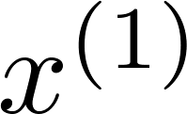
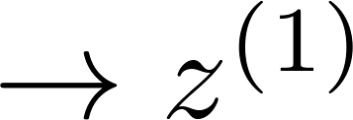
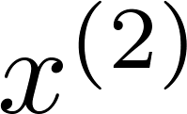
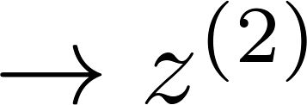
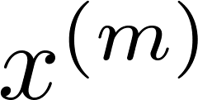
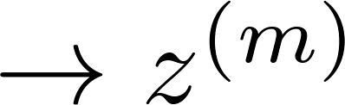


Data Compression
Reduce data from
2D to 1D
(inches)
(cm)
Andrew Ng
Notes:
Quick ask: Which variables in your datasets are obviously redundant or strongly correlated—and what single summary would you replace them with?

Slide 11
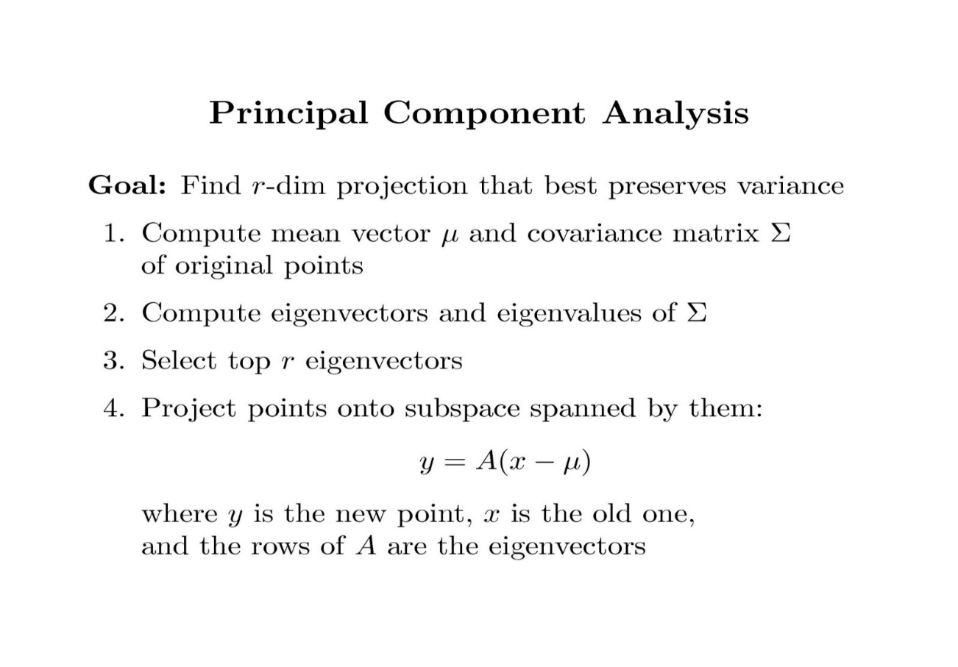
Pseudo Code
Eigenvectors = directions (axes) in feature space.
Eigenvalues = how much variance exists along those directions.
x is your original D-dimensional data point (e.g., one trip, one vehicle snapshot, one part).
(x − μ) means “center it.”
A is a matrix built from the selected eigenvectors.
y is the new r-dimensional representation (compressed features).
Multiplying by A is like taking dot-products with each principal direction and measuring “how much x lies along each direction.”
Notes:
Eigenvectors give candidate directions; eigenvalues tell how important each direction is—like an ‘importance score’ for variance.
Suppose each trip is represented by 100 features: speed stats, braking stats, throttle variance, acceleration jerk, idle time, etc. PCA might compress this into 3 components:
Component 1: ‘Aggressive vs smooth’
Component 2: ‘City stop-go vs highway cruising’
Component 3: ‘Load/grade/traffic stress

Slide 12
Covariance
Variance and Covariance:
Measure of the “spread” of a set of points around their center of mass(mean)
Variance:
Measure of the deviation from the mean for points in one dimension
Covariance:
Measure of how much each of the dimensions vary from the mean with respect to each other
Covariance is measured between two dimensions
Covariance sees if there is a relation between two dimensions
Covariance between one dimension is the variance
Notes:
variance is the simplest: it tells us how much a single variable changes around its mean. If a signal barely changes—like a sensor stuck near a constant value—its variance is small, and it usually doesn’t help much for discrimination.
Now covariance extends this idea to two variables together. It answers: when variable X moves away from its mean, does variable Y also move away from its mean in a consistent way?
So, covariance is basically: do two variables ‘dance together’?
If covariance is positive, when X goes up, Y tends to go up too. If covariance is negative, when X goes up, Y tends to go down. If covariance is near zero, then there’s no strong linear co-movement—at least not linearly.
covariance of a variable with itself is just variance—because it’s measuring how that one variable varies from its mean

Slide 13
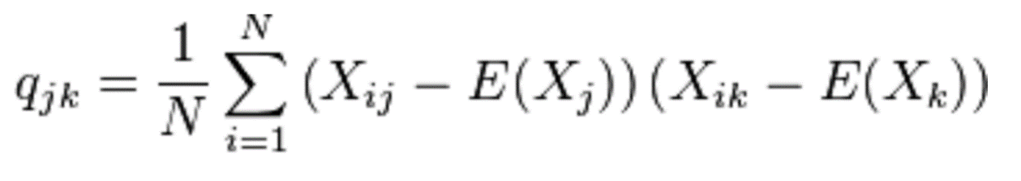
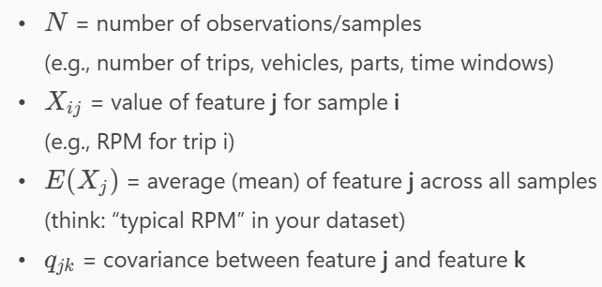
Covariance
Used to find relationships between dimensions in high dimensional data sets

Slide 14


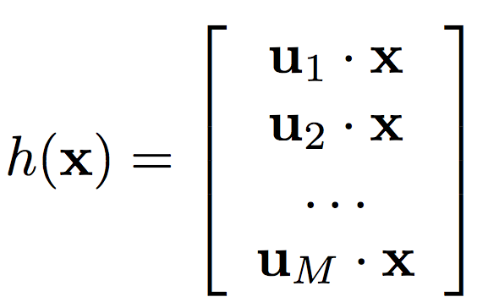

Principal Component Analysis
Input:
Set of basis vectors:
Summarize a D dimensional vector X with K dimensional feature vector h(x)
Notes:
PCA creates a new coordinate system and represents each sample by its projections onto the top K directions.

Slide 15
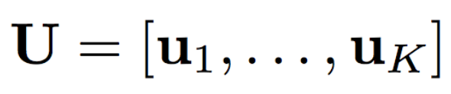
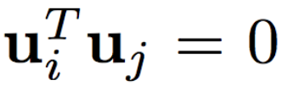
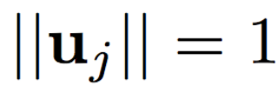

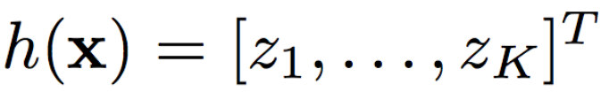
Principal Component Analysis
Basis vectors are orthonormal
New data representation h(x)
Notes:
We want each component to capture something new, not a repeat of previous components. That’s why PCA forces basis vectors to be orthogonal: component 2 must not reuse the information already captured by component 1.

Slide 16
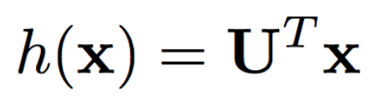
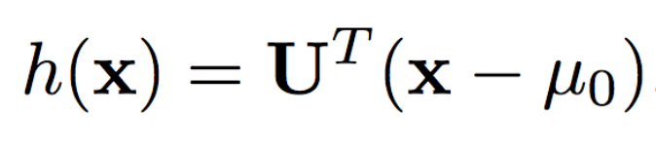
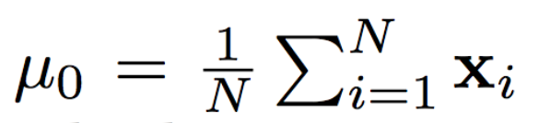
Principal Component Analysis
New data representation h(x)
Empirical mean
Notes:
First, we compute the empirical mean $μ_{0}$— basically the ‘average vehicle’ or ‘average part.’ Then we subtract it so PCA focuses on variation, not absolute levels. After centering, projecting is just one matrix multiplication: $U^{T}\left(x−μ_{0}\right)$

Slide 17
Computing the Components
E((u.x)²) = E ((u.x) (u.x)^{T}) = E (u.x.x ^{T}.u^{T})
The matrix C = x.x^{T} contains the correlations (similarities) of the original axes based on how the data values project onto them
So we are looking for w that maximizes uCu^{T}, subject to u being unit-length
It is maximized when w is the principal eigenvector of the matrix C, in which case
uCu^{T} = uλu^{T} = λ if u is unit-length, where λ is the principal eigenvalue of the correlation matrix C
The eigenvalue denotes the amount of variability captured along that dimension
Notes:
Projection of $x$onto direction $u$is $u⋅x$.
Largest eigenvector = first principal component.
Eigenvalue = variance captured along that component.
why does PCA pick those axes? PCA is literally asking: which direction gives the biggest spread when I project data onto it? Because bigger spread usually means better discrimination and more signal.
So: eigenvector gives the direction, eigenvalue tells the importance.”

Slide 18
Why the Eigenvectors?
Maximise u^{T}xx^{T}u s.t u^{T}u = 1
Construct Langrangian u^{T}xx^{T}u – λu^{T}u
Vector of partial derivatives set to zero
xx^{T}u – λu = (xx^{T} – λI) u = 0
As u ≠ 0 then u must be an eigenvector of xx^{T} with eigenvalue λ
Notes:
We want the direction $u$that maximizes variance, but we must constrain $u$to unit length, otherwise the objective can grow forever. When you solve this constrained optimization using Lagrange multipliers, you naturally end up with the eigenvector equation. So eigenvectors aren’t random — they are the optimal solution to ‘maximize variance with unit-length constraint.’

Slide 19
Singular Value Decomposition
The first root is called the prinicipal eigenvalue which has an associated orthonormal (u^{T}u = 1) eigenvector u
Subsequent roots are ordered such that λ₁> λ₂ >… > λ_{M} with rank(D) non-zero values.
Eigenvectors form an orthonormal basis i.e. u_{i}^{T}u_{j} = δ_{ij}
The eigenvalue decomposition of xx^{T} = UΣU^{T}
where U = [u₁, u₂, …, u_{M}] and Σ = diag[λ ₁, λ ₂, …, λ _{M}]
Similarly the eigenvalue decomposition of x^{T}x = VΣV^{T}
The SVD is closely related to the above x=U Σ^{1/2} V^{T}
The left eigenvectors U, right eigenvectors V,
singular values = square root of eigenvalues.
Notes:
Singular values are square roots of eigenvalues.
This slide says: in practice we often compute PCA using SVD, not by explicitly forming the covariance matrix. Why? SVD is numerically stable and works well when D is huge or N is huge. The key relationship is: PCA and SVD are two views of the same thing. Eigenvectors give the principal directions; singular values give the strength of each direction. If someone remembers one thing: PCA can be implemented via SVD and singular values tell you how much variance each component holds.
SVD is the practical engine behind PCA, especially at scale.

Slide 20
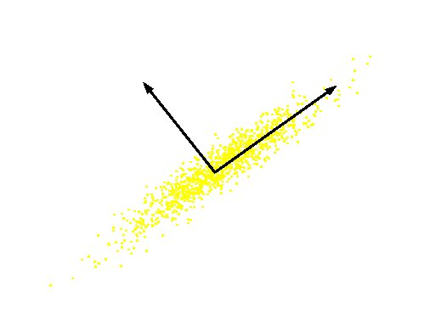
Computing the Components
Similarly for the next axis, etc.
So, the new axes are the eigenvectors of the matrix of correlations of the original variables, which captures the similarities of the original variables based on how data samples project to them
Geometrically: centering followed by rotation
Linear transformation
Notes:
This is the most important intuition slide. PCA does two simple geometric steps: 1) Centering: move the data cloud so the mean is at the origin. 2) Rotation: rotate the coordinate axes so that the first axis points along the longest spread of the cloud. Then we keep only the first few rotated axes and drop the rest. That’s why PCA is often described as ‘centering followed by rotation.’ And because it’s just rotation + projection, it’s a linear transformation.

Slide 21
PCs, Variance and Least-Squares
The first PC retains the greatest amount of variation in the sample
The k^{th} PC retains the k^{th} greatest fraction of the variation in the sample
The k^{th} largest eigenvalue of the correlation matrix C is the variance in the sample along the k^{th} PC
The least-squares view: PCs are a series of linear least squares fits to a sample, each orthogonal to all previous ones

Slide 22
Dimensionality Reduction
Can ignore the components of lesser significance.
Do lose some information, but if eigenvalues are small, don’t lose much

Slide 23
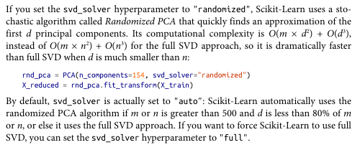
Randomized PCA
Notes:
This slide is about making PCA practical when the dataset is huge. Standard PCA typically uses SVD under the hood, and full SVD can become slow when you have many samples or many features—think millions of rows, or 2,000+ dimensions in embeddings. Randomized PCA is a clever approximation: instead of doing the exact heavy computation, it uses random projections to quickly find a good approximation of the top principal components. The key message: we usually care about the top 10, 20, 100 components, not the full decomposition. Randomized PCA focuses computational effort on those top components—so it becomes dramatically faster with very little loss in quality.
Now, speed is one issue. The next issue is: what if data doesn’t even fit in memory? That’s Incremental PCA.

